Slide 1

PYTHON Libraries
Demystifying the World of Artificial Intelligence and Exploring Its Potential
Artificial Intelligence

Slide 2
Modules VS Packages VS Libraries
Modules : help in organizing related functions and classes into a single file, making code more manageable and reusable.
Functions
Functions
Functions
Artificial Intelligence

Slide 3
Modules VS Packages VS Libraries
Modules : help in organizing related functions and classes into a single file, making code more manageable and reusable.
Module
Functions
Functions
Functions
File.py
Artificial Intelligence

Slide 4
Modules VS Packages VS Libraries
Modules : help in organizing related functions and classes into a single file, making code more manageable and reusable.
Package
Packages : allow for a hierarchical structuring of the module namespace using dot notation, making it easier to organize and manage large codebases.
__init__.py
Module
Module
Module
Functions
Functions
Functions
Functions
Functions
Functions
Functions
Functions
Functions
File.py
File.py
File.py
Artificial Intelligence

Slide 5
Modules VS Packages VS Libraries
Modules : help in organizing related functions and classes into a single file, making code more manageable and reusable.
Library
Packages : allow for a hierarchical structuring of the module namespace using dot notation, making it easier to organize and manage large codebases.
Package
Package
__init__.py
__init__.py
Module
Module
Module
Module
Module
Module
Functions
Functions
Functions
Functions
Functions
Functions
Functions
Functions
Functions
Functions
Functions
Functions
Libraries: extend Python's capabilities by providing additional tools and utilities for various tasks, such as numerical computations, data analysis, web development, and more.
Functions
File.py
Functions
File.py
Functions
File.py
Functions
File.py
Functions
File.py
Functions
File.py
Package
Package
__init__.py
__init__.py
Module
Module
Module
Module
Module
Module
Functions
Functions
Functions
Functions
Functions
Functions
Functions
Functions
Functions
Functions
Functions
Functions
Functions
File.py
Functions
File.py
Functions
File.py
Functions
File.py
Functions
File.py
Functions
File.py
Artificial Intelligence

Slide 6
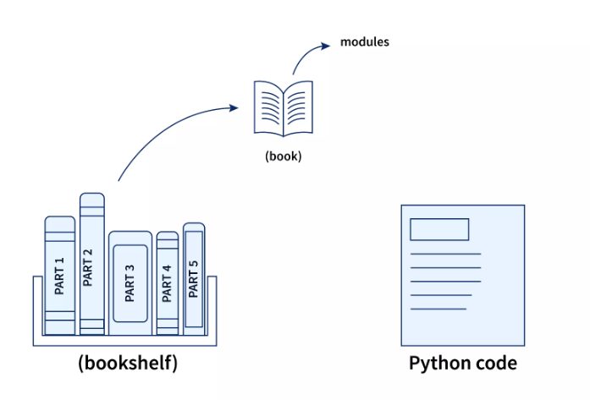
WHAT ARE Python Libraries?
Artificial Intelligence

Slide 7
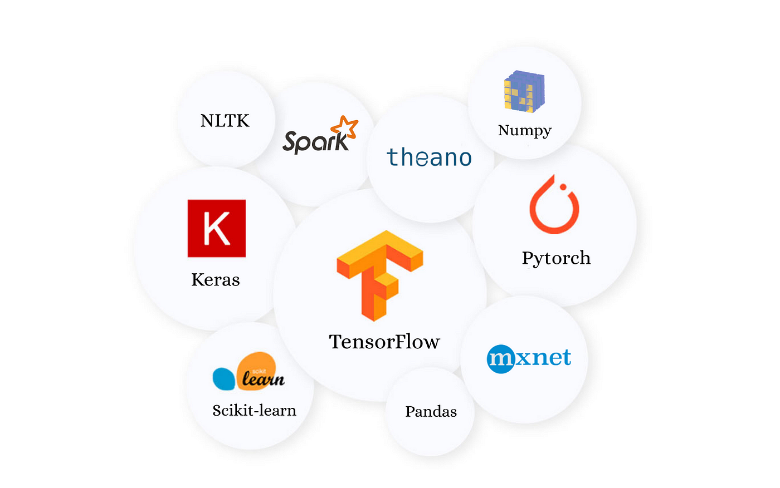
WHAT ARE Python Libraries?
Python libraries are collections of pre-written code and functions that extend the capabilities of the Python programming language.
They provide a wide range of tools and modules for various tasks, making it easier for developers to work on specific tasks without reinventing the wheel.
Artificial Intelligence

Slide 8
WHAT ARE Python Libraries?
Python Libraries Types:
ex:
  OS
  Sys
  Math
  datetime
Standard libraries : Python comes with a standard libraries that include many modules for preforming common Tasks.
Standard libraries : Available by default but need to be imported.
Artificial Intelligence

Slide 9
WHAT ARE Python Libraries?
Python Libraries Types:
Standard libraries : Python comes with a standard libraries that include many modules for preforming common Tasks..
Builtins libraries : Special subset of the Standard libraries , that are automatically loaded into python.
Builtins : Always available without importing
Standard libraries : Available by default but need to be imported.
Artificial Intelligence

Slide 10
WHAT ARE Python Libraries?
Python Libraries Types:
ex:
  Numpy
  Pandas
  Matplotlib
  Scikit-learn
2. Third-party libraries : These are created by the community and can be installed using package manager like ‘pip’.
Third-party libraries : Need to be installed first, then importing.
Standard libraries : Available by default but need to be imported.
Builtins : Always available without importing
Artificial Intelligence

Slide 11
WHAT ARE Python Libraries?
Python Libraries Types:
Builtins : Always available without importing
Standard libraries : Available by default but need to be imported.
Third-party libraries : Need to be installed first, then importing.
Artificial Intelligence

Slide 12

Artificial Intelligence

Slide 13
What is NumPy?
NumPy: is a Python Third-Party Module To Deal With Arrays & Matrices
Stand for Numerical Python
Open Source
Support dealing with Large Multidimensional Arrays.
Has many Mathematical Functions to deal with these elements
Artificial Intelligence

Slide 14
What is NumPy?
NumPy: is a Python Third-Party Module To Deal With Arrays & Matrices
Why we use NumPy Arrays?
Consume Less Memory
Very Fast Compared To Python List
Easy To Use
Support Element Wise Operation
Elements are stored Contiguous
Artificial Intelligence

Slide 15
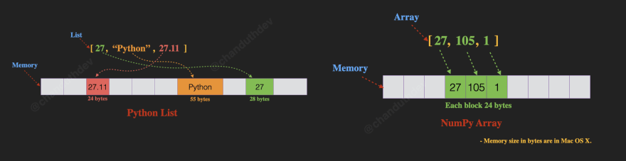
Python List VS Numpy Array
Artificial Intelligence

Slide 16
Python List VS Numpy Array
Python Lists
Homogeneous => Can Contains The Same Type of Objects
Heterogeneous => Can Contains Different Types of Objects.
Numpy Array
The Items in the Array have to be of the Same Type.
You can be sure what is the Storage Size needed for the array.
NumPy Arrays are indexed From 0
Artificial Intelligence

Slide 17
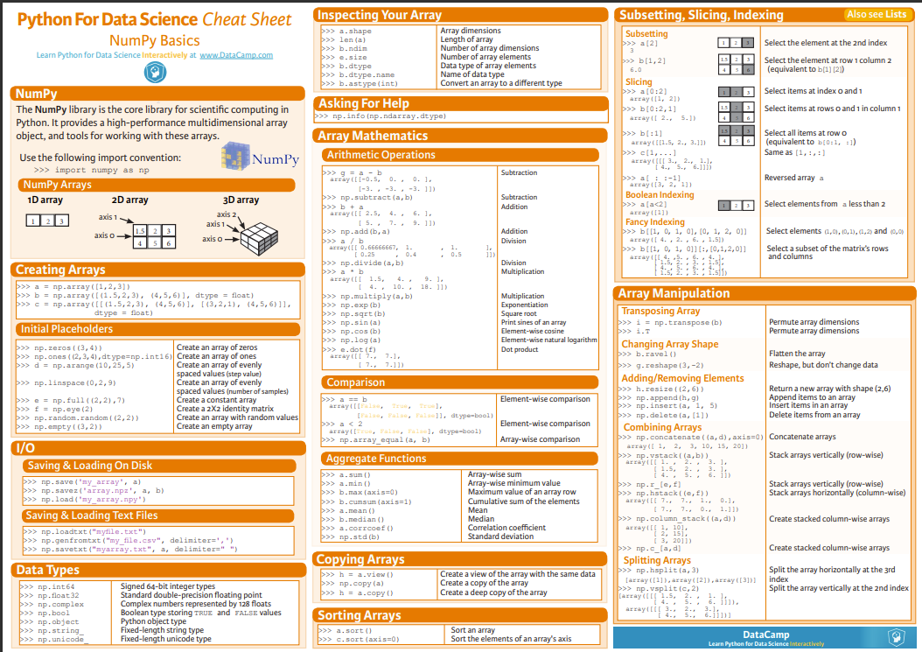
Artificial Intelligence

Slide 18
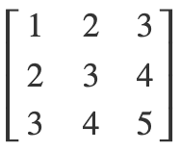
Square Matrix
3 columns
A square matrix is a matrix that has an equal number of rows and columns.
3 rows
Artificial Intelligence

Slide 19
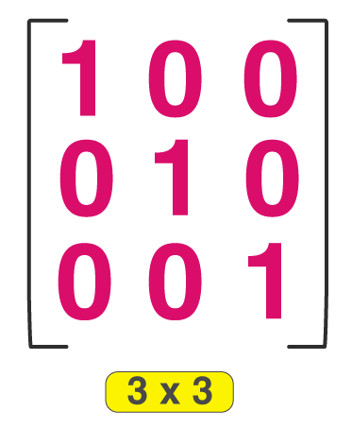
Identity Matrix
Artificial Intelligence

Slide 20
Identity Matrix
An identity matrix is a special kind of square matrix in which all the elements of the principal diagonal are ones, and all other elements are zeros.
The identity matrix plays a crucial role in linear algebra, especially in matrix multiplication, where it acts as the multiplicative identity element.
This means that multiplying any matrix by an identity matrix of compatible dimensions leaves the original matrix unchanged.
Artificial Intelligence

Slide 21
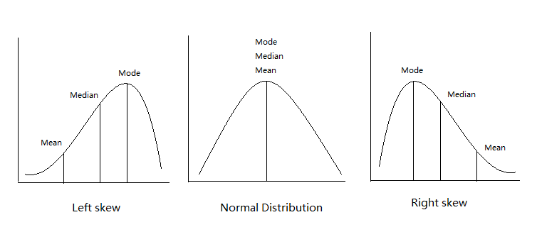
Mean –
Mode –
Median
Artificial Intelligence

Slide 22
Mean –
Mode –
Median
Mon | Tue | Wed | Thu | Fri | Sat | Sun
5 | 3 | 8 | 3 | 15 | 45 | 9
Artificial Intelligence

Slide 23

Mode –
Median
Mon | Tue | Wed | Thu | Fri | Sat | Sun
5 | 3 | 8 | 3 | 15 | 45 | 9
Mean –
The mean (or average) is the sum of all the values in a data set divided by the number of values.
$$Mean=\frac{5+3+8+3+15+45+9}{7}=12.5$$
Artificial Intelligence

Slide 24

Mean –
Median
Mon | Tue | Wed | Thu | Fri | Sat | Sun
5 | 3 | 8 | 3 | 15 | 45 | 9
$$Mean=\frac{5+3+8+3+15+45+9}{7}=12.5$$
Mode –
The mode is the value that appears most frequently in a data set. A data set may have one mode, more than one mode, or no mode at all.
Mode = 3
5 3 8 3 15 45 9
Artificial Intelligence

Slide 25
Mean –
Mode –
Mon | Tue | Wed | Thu | Fri | Sat | Sun
5 | 3 | 8 | 3 | 15 | 45 | 9
Median
$$Mean=\frac{5+3+8+3+15+45+9}{7}=12.5$$
The median is the middle value in a data set when the values are arranged in ascending order.
If the number of values is even, the median is the average of the two middle values.
Mode = 3
3 3 5 8 9 15 45
Median = 8
Artificial Intelligence

Slide 26


Artificial Intelligence

Slide 27
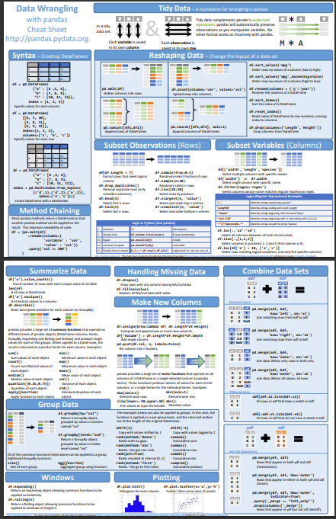
Artificial Intelligence

Slide 28
THANK YOU!
Any Question!
The End

